Slide 1
Christchurch
East School
Team Koru 2022
Distance Learning Slide Deck

Slide 2
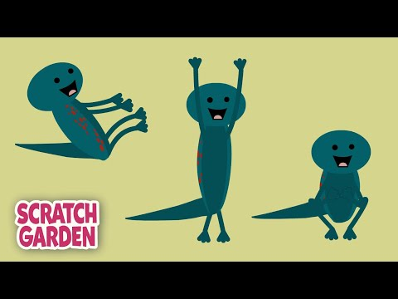
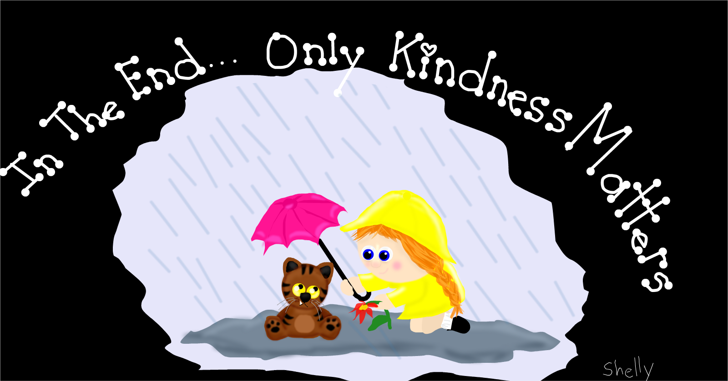
Values Focus
Equity - Te Ririte | Excellence - Te Hiranga | Integrity - ​​Ngākau Pono | Sense of Community - Nohonga Tahitanga
In Team Koru we treat each other fairly, and with kindness. Plan over the next week to do a kind thing for someone each day. E.g. Make your mum a card, draw a picture or make something for someone else. | In Team Koru we strive to do our personal best. Set a goal for yourself to achieve over the next week, and work on it! Learn a song, a dance. Make up a game or set a fitness task everyday. Challenge yourself!!! | In Team Koru we are honest in our words and actions. Be mindful… watch this video to help you improve your mindfulness. | In Team Koru we care for each other and where we come from.

Slide 3
Five Ways to Wellbeing
Get Active | Give | Connect | Keep Learning | Take Notice
Teach someone in your family the Left Right song Left/right Scratch Garden Play Simon Says Sing and action some nursery rhymes Incy Wincy, Twinkle Twinkle ….. | Tidy up your toys.. Make your bed and keep your bedroom space tidy. Do an act of kindness for someone in your family group | Play Buzz with your family Listen to any noises around your house- birds singing, cars, wind blowing, cicadas, music-can you name the sounds | Mathletics Storyline online Practice saying and writing the days of the week Days of the week | Write a note or draw a picture for someone-could be a kind word, a surprise, a joke or a picture

Slide 4
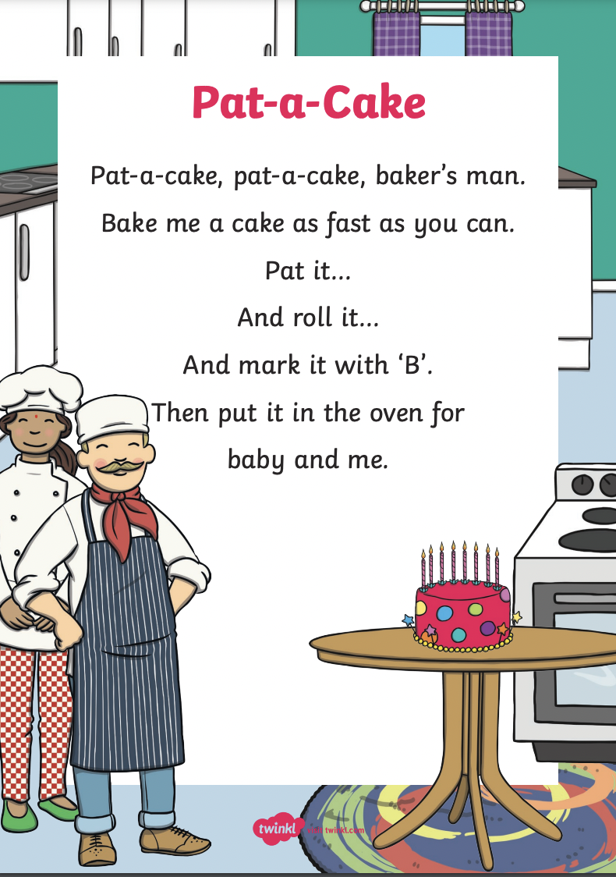
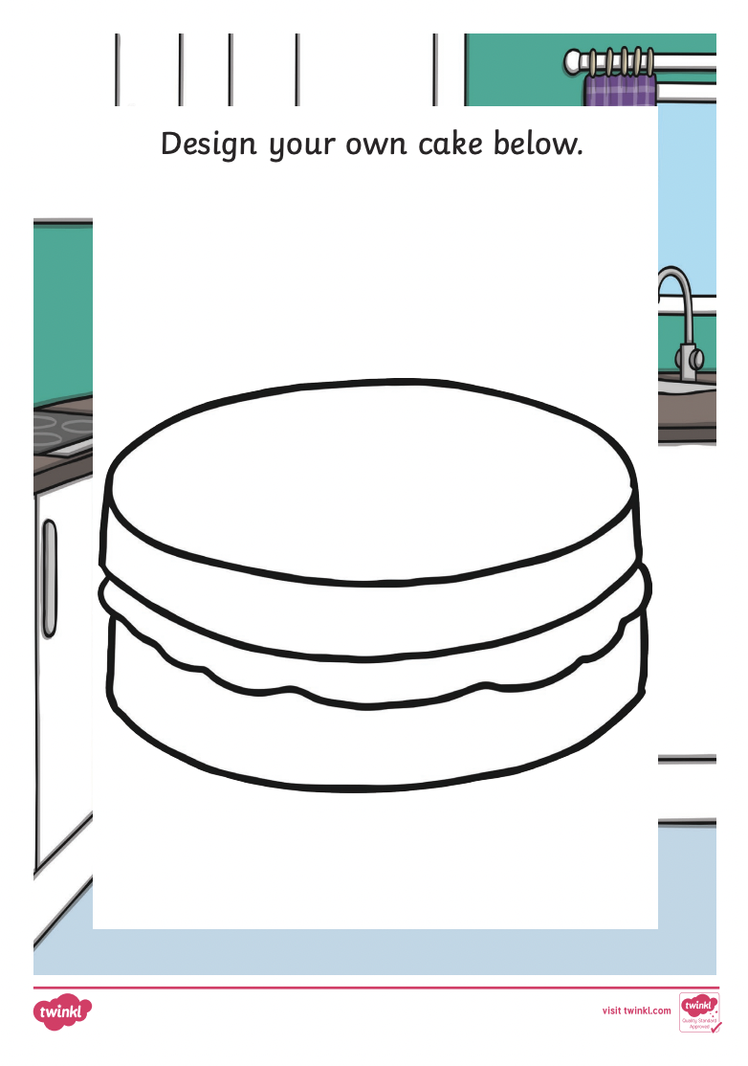
Reading
Learn the Nursery Rhyme Pat-a-Cake
Make some actions to the rhyme.
Teach the rhyme and the actions to someone else.
Design your own cake.
How many words can you write using the -at word family?
Pat
______
______
______
______

Slide 5
Tricky Word Game
Try this Tricky Word game for size.
It works like noughts and crosses. ( 0 and X’s)
Have fun playing it.
Follow the link …… and away you go!
Tricky Word game.

Slide 6
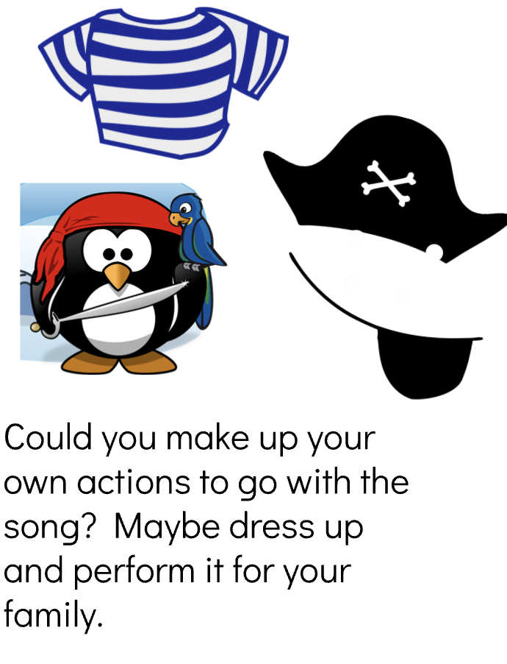
Reading - A Singalong book “The Port Side Pirates” Written by Oscar Seaworthy
Activities
Can you explain what ‘port side’ or ‘starboard’ mean on a boat? How could you remember which is which, if you were on a boat?
Maybe you could design a pirate ship and label the parts. Make sure you add lots of detail.
Listen to the singalong story by clicking on the picture.

Slide 7
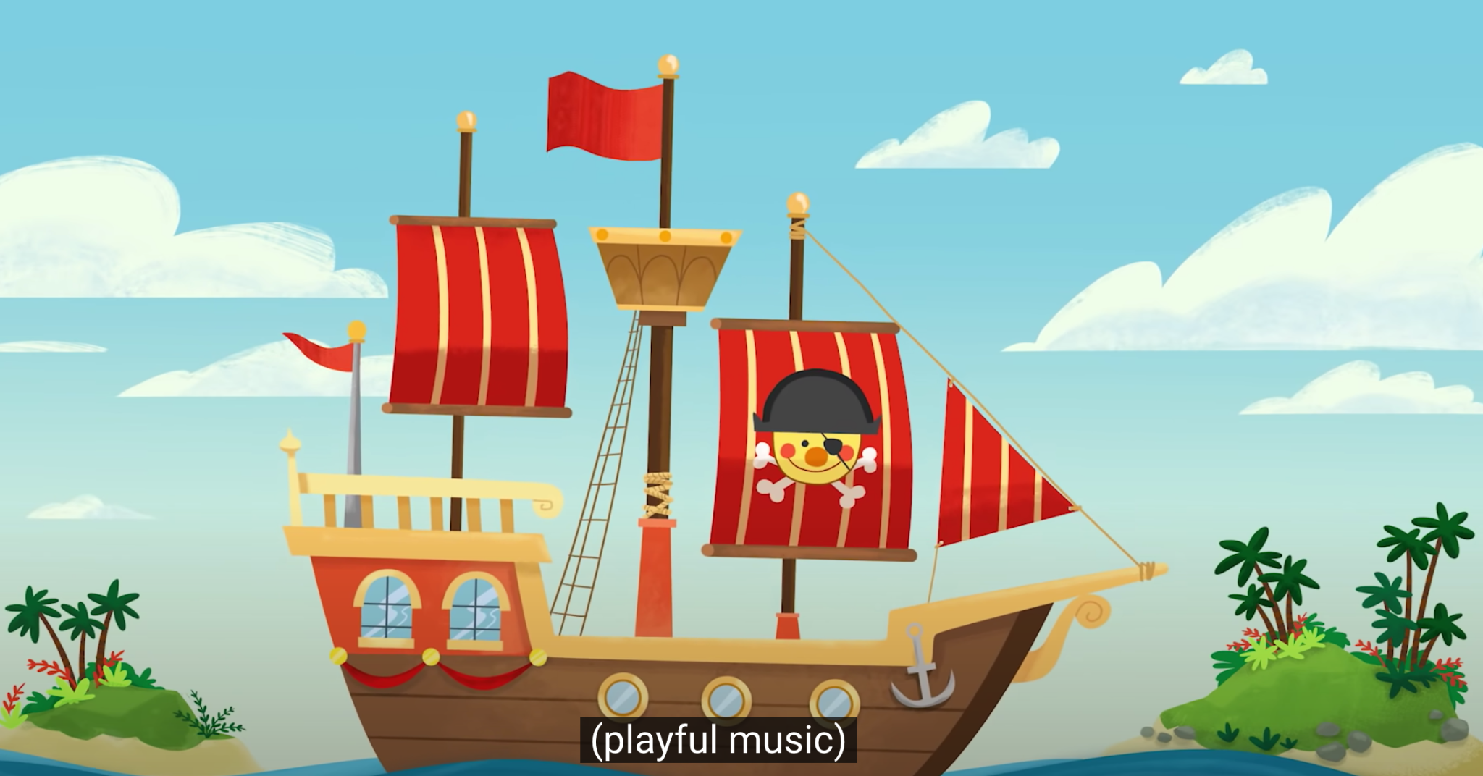
Now do some movement to the
“Over the Deep Blue Sea “ song
Click on the link
Over the Deep Blue Sea Song

Slide 8
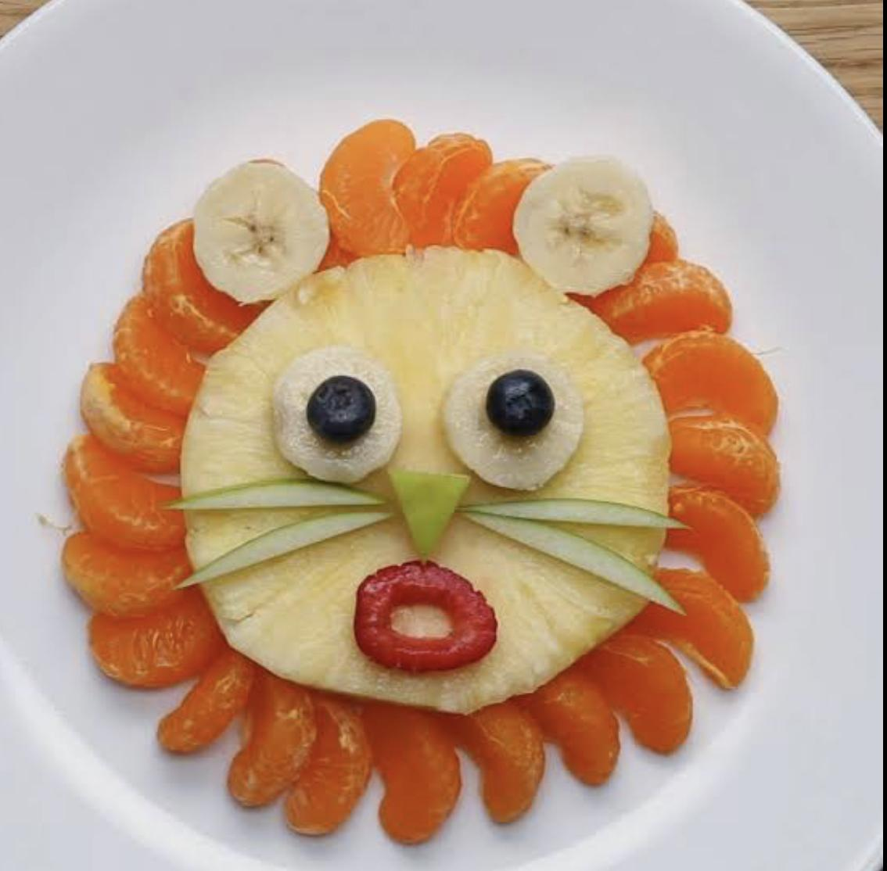
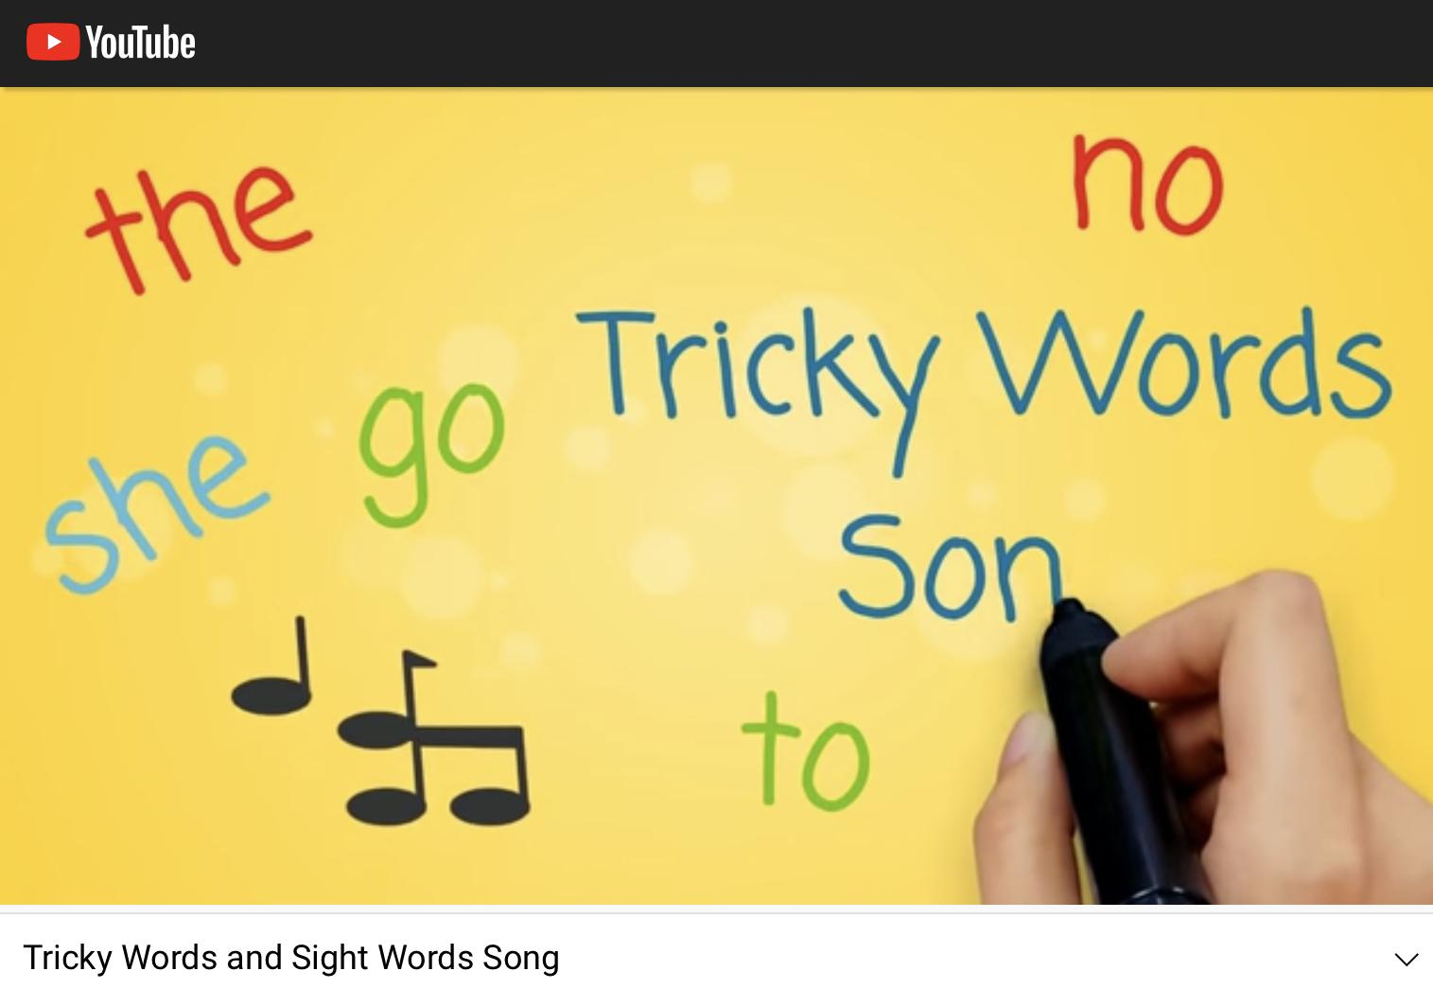
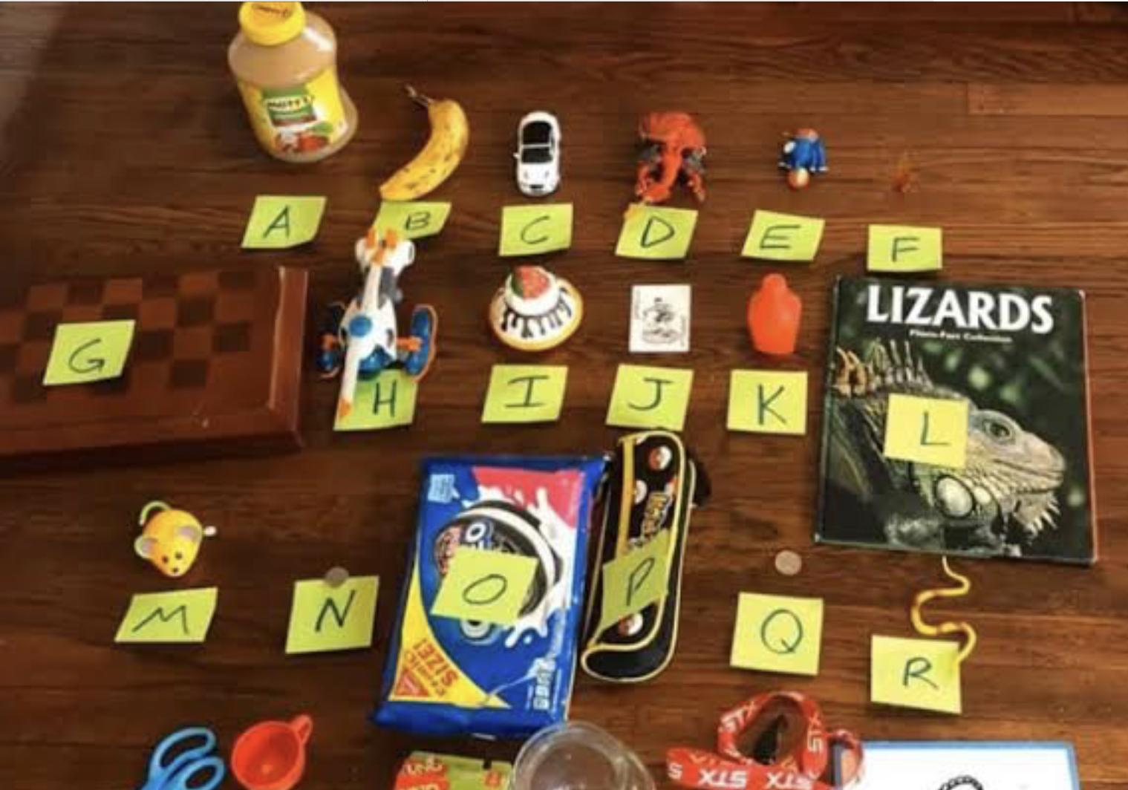
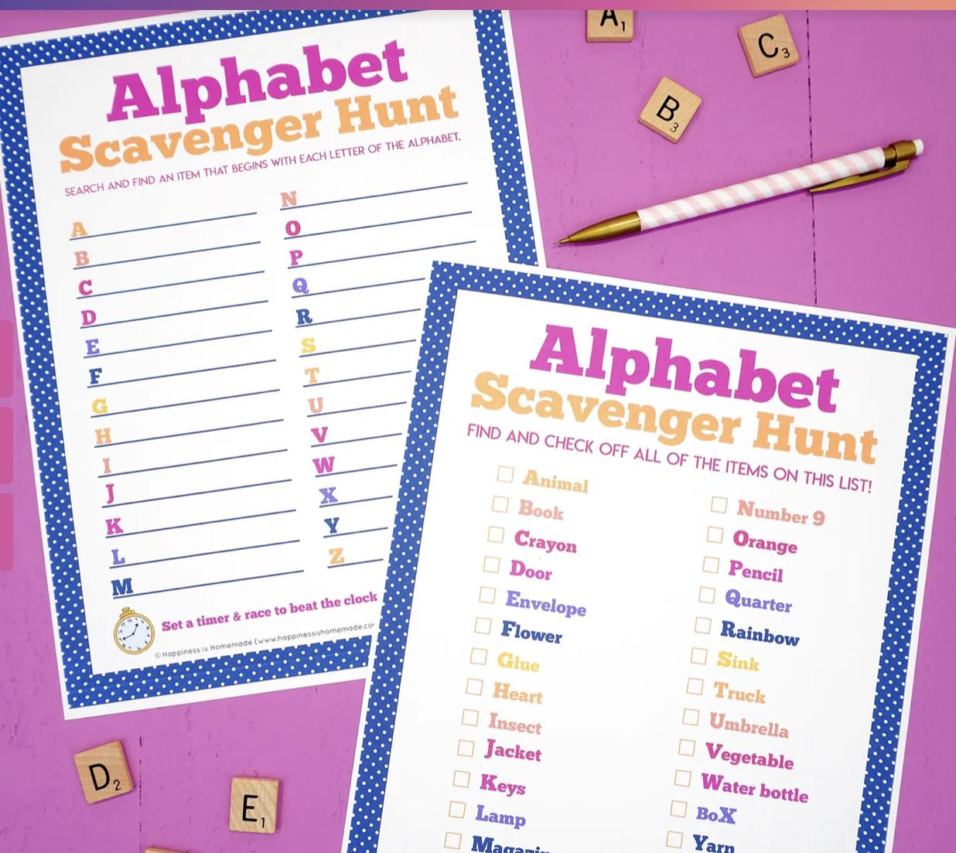
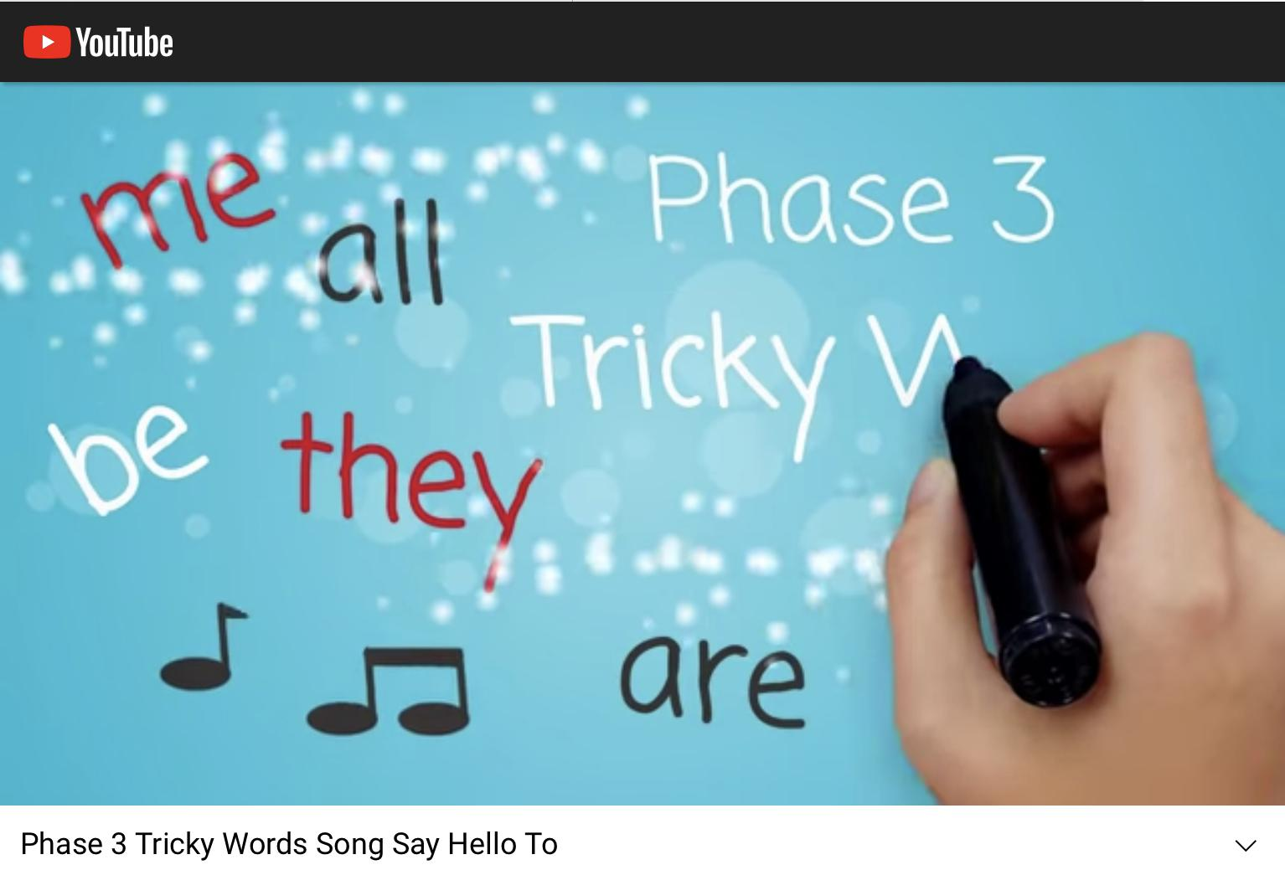
Writing
Go on an ‘Alphabet Scavenger Hunt’ at home, around the garden or park.
Write some sentences about these funny pictures!
Grab your favourite pen, click the YouTube links below, and practice some ‘Tricky Words’
Draw a speech bubble and write what this police officer might be saying.

Slide 9
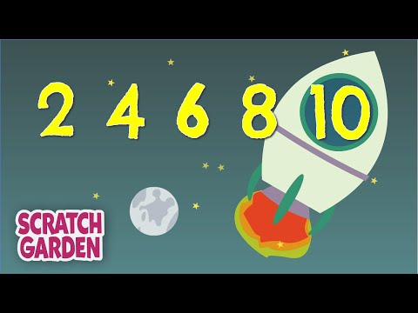
Maths
Challenge #1: Finding and naming shapes:
What kind of shapes can you find around your house and/or garden??
Can you name them?
Take a photo or draw these shapes.
What makes them the same?
What makes them different?
Mathletics Challenge!
Have a go earning some points on mathletics… Can you get 1000 points this week?
Position and Orientation
Counting by 2’s…

Slide 10
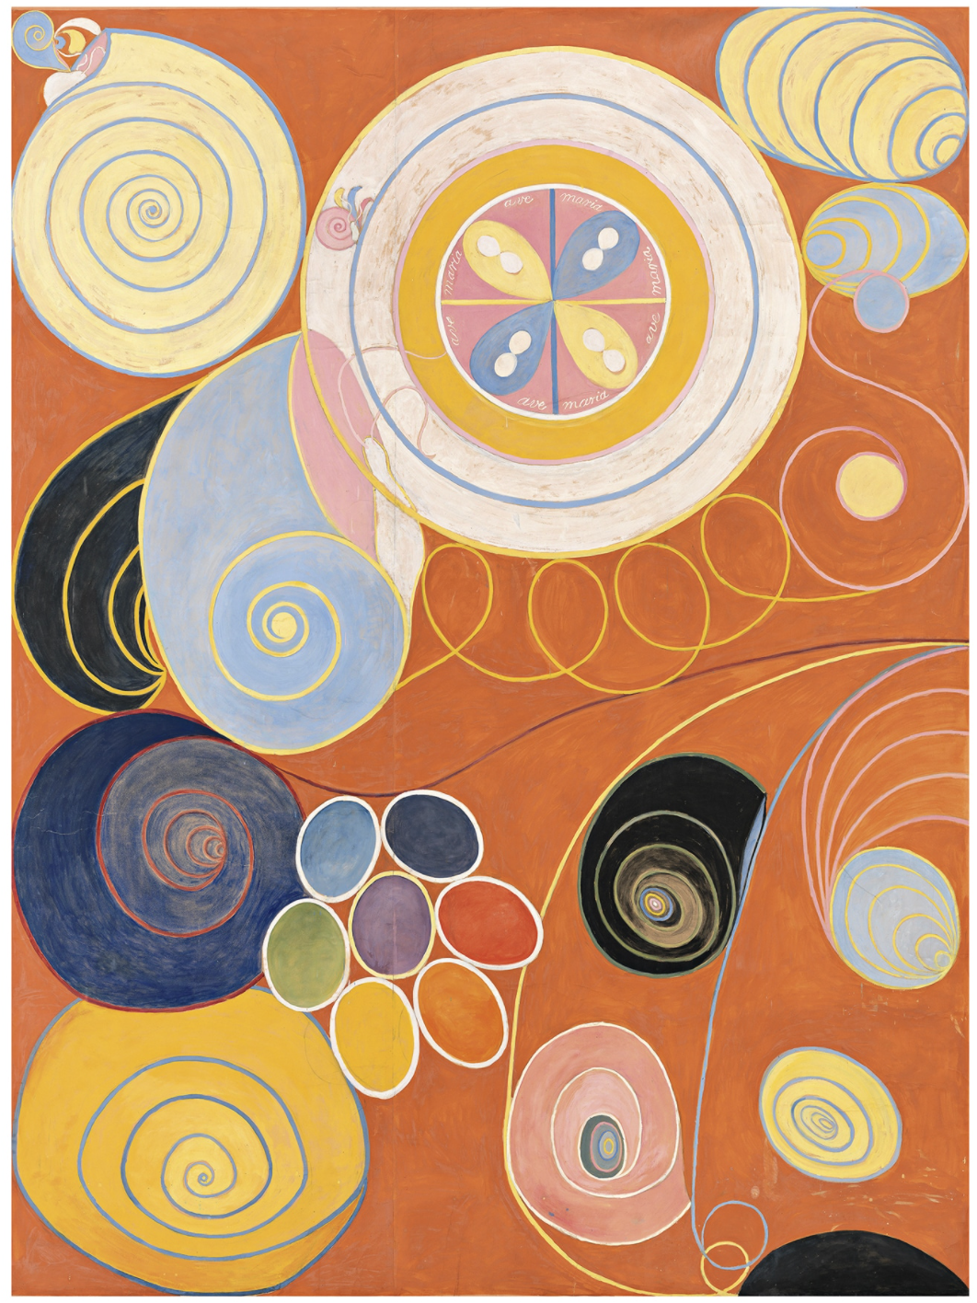
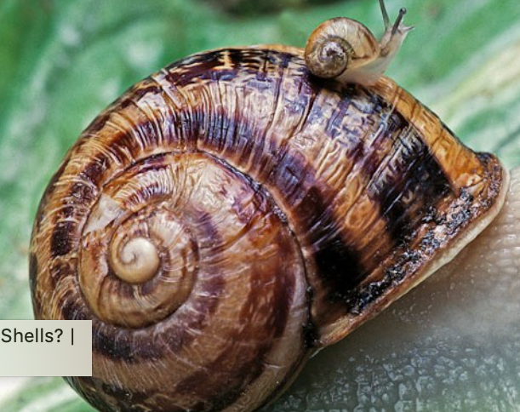
Art
Abstract drawing - Hilma Klint style
See if you can find a snail in your garden and have a look at its shell. There’s a lot of snails around at the moment. (Or find some pictures of snails online). A snail has a spiral pattern on its shell. Spiral patterns are used a lot in art.
Check out the link to Hilma Klint, a famous Swedish artist, and see if you can draw and colour spiral shapes to make a picture.
You can use pencil, crayons, felts, paint or pastels - whatever you have at home.

Slide 11
Physical Education
Can't stop the feeling Follow the tutorial to this song- you could add your ow moves too!
Make a fitness course at home - add cushions to jump on, toys to jump over, spaces to hop, walls to push against, star jumps etc . Record this fitness circuit - and you could share this when you come back to school

Slide 12
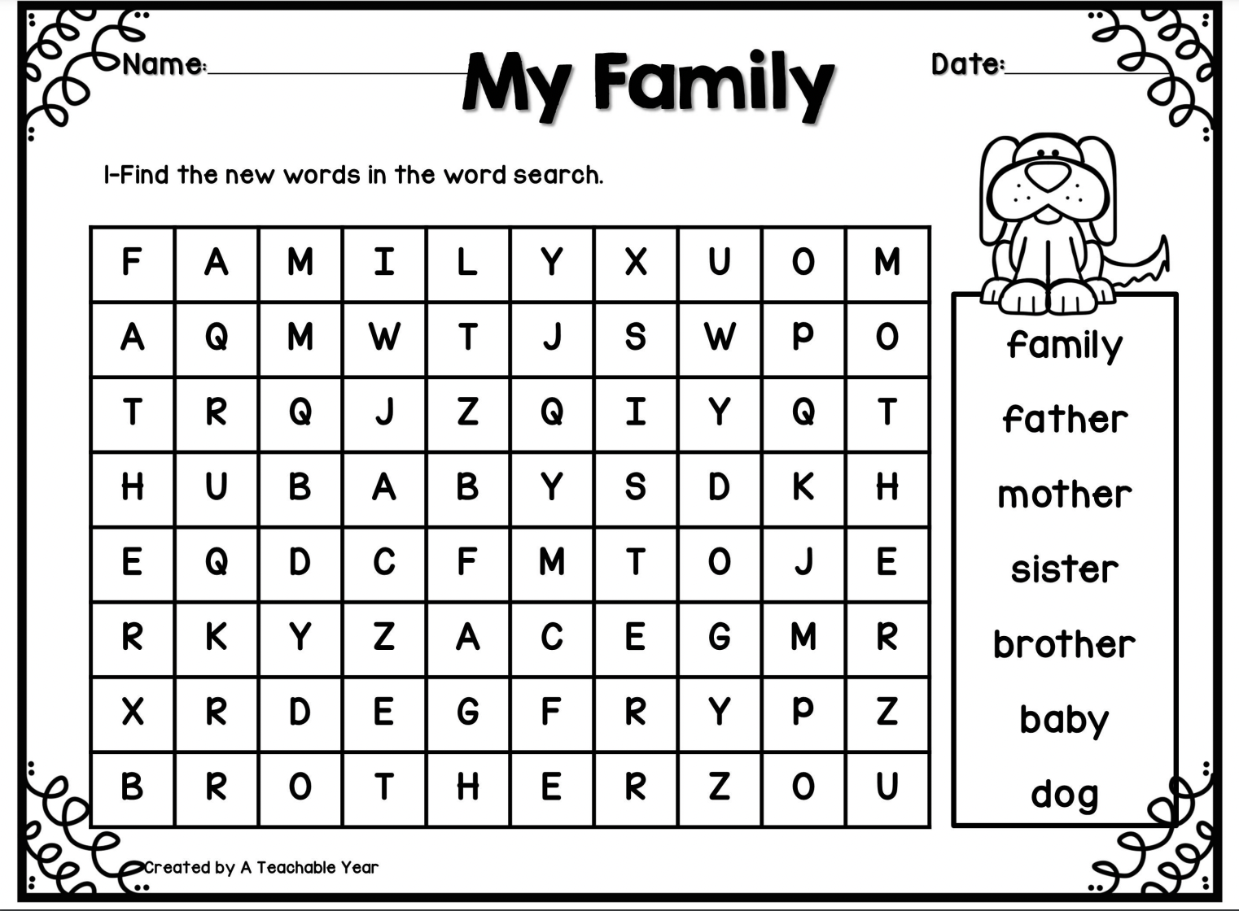
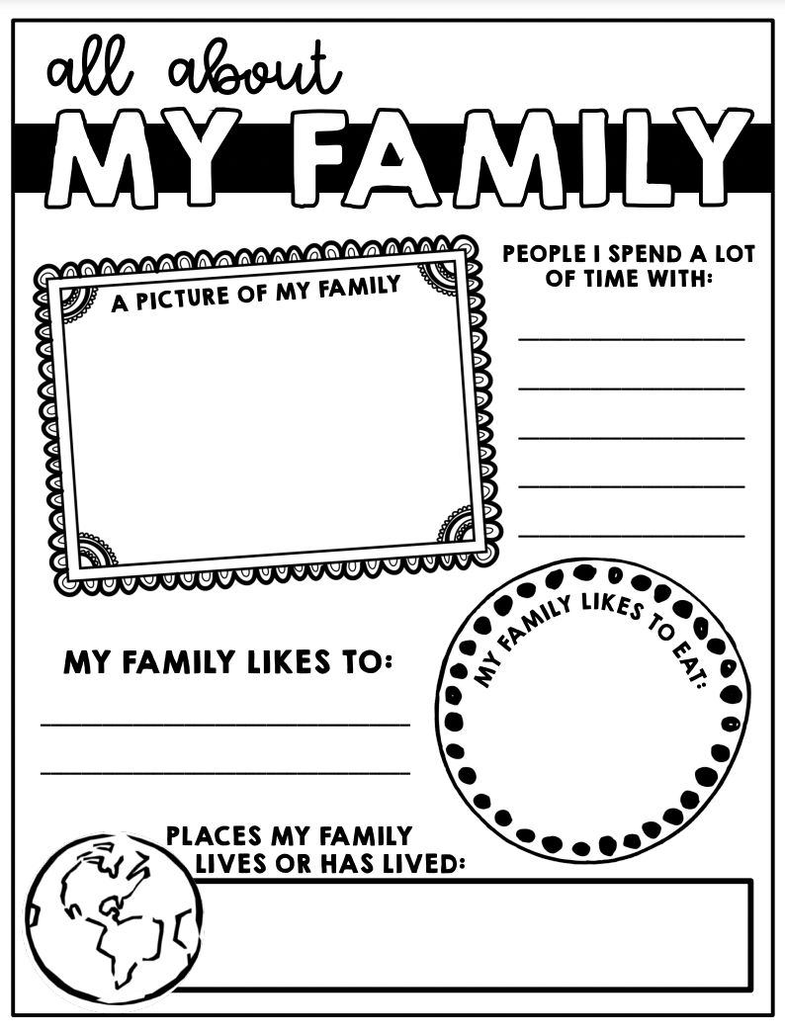
Inquiry - Complete the activities

Slide 13
Extra - Anyone

