Slide 2
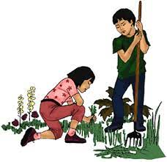
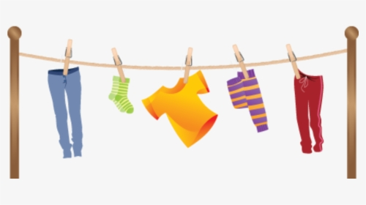
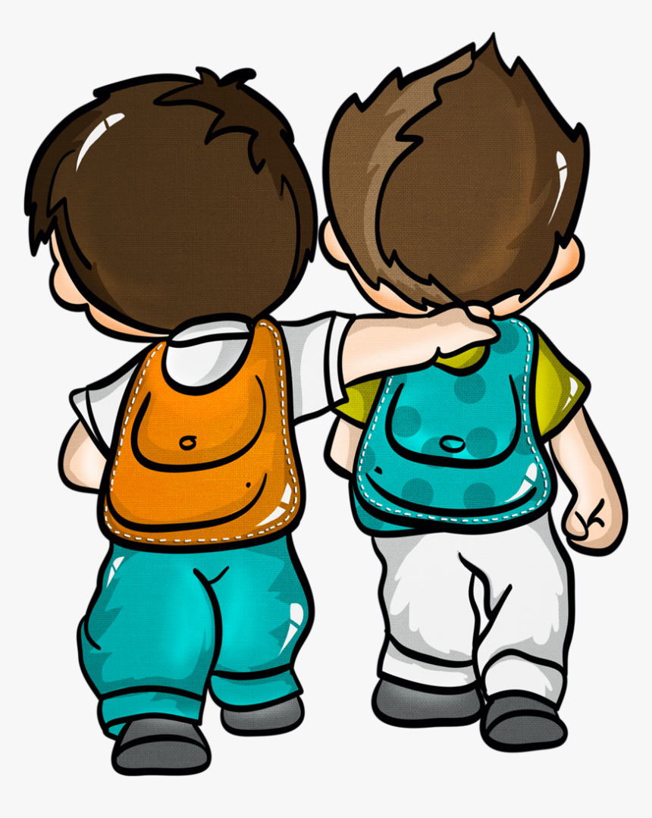
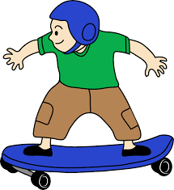
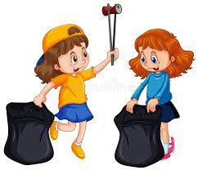
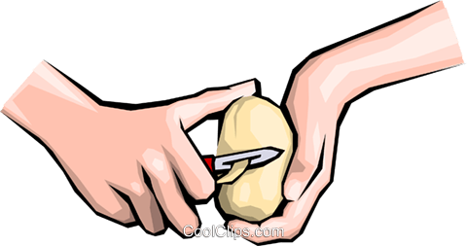
Values Focus
Equity - Te Ririte | Excellence - Te Hiranga | Integrity - ​​Ngākau Pono | Sense of Community - Nohonga Tahitanga
Notice if someone in your family could use some help - and share the load. | Choose a new skill to learn and practice until you’re awesome at it. | Make good choices while you’re at home. Think about how you can impact others. | Do something to help around your neighbourhood.

Slide 3
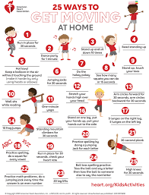
Five Ways to Wellbeing
Get Active | Give | Connect | Keep Learning | Take Notice
 | 😇 Help do a job at home. 😍 Say thank you to someone for helping you. 😊 Smile at the people around you. | 📱 Ring a friend for a chat. 🎧 Listen to your favourite music. 🐦 Listen to the birds outside. | 🧠 Watch You tube or read a book to learn how to do something new, then try it and share it! | Take notice of your breathing - try Mind Yeti

Slide 4
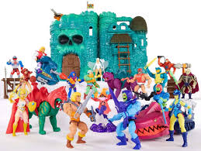
Reading
Click on the picture to listen to the story. | Go to Epic using the class code vuk0394 and choose some books to read. Click on the picture. | Go to Hapara to find some reading tasks to do. Click on the picture. | Click on the link below to do a Masters of the Universe word search!

Slide 5
Writing Activity 1
At 12.01 am on your birthday you receive a phone call from your much loved but extremely eccentric Nana (who also happens to be incredibly wealthy). She tells you that she's giving you an island of your own just off the coast of Aotearoa. Your task is to draw a map of your island (I recommend A3 sized paper or even bigger if you have it).
You must include colour (coloured pencil looks best)
Compass markings
You must have at least 5 major landmarks on your island e.g., a forest, mountains, volcano, haunted cave, buried treasure etc. More landmarks are encouraged.
Your island must have a name
Include labels showing what the landmarks are

Slide 6
Writing Activity 2
Your rich and eccentric Nana is keen for you to head on out to your new island as soon as possible. Your next task is to design transport to your island. This could be any kind of land or sea vehicle.
It must include a place to store the stuff you're taking with you.
It must also have a place to sleep and something to entertain you on the journey.
Some kind of defence system is recommended. The island is surrounded by pirates most of the time. Try to design your vehicle so it's hard to follow.
Use A3 paper if you have it; include labels telling us about the features of the vehicle and make sure you include colour.

Slide 7
Writing Activity 3
You're finally ready to head on out to your island. Your transport is ready to go and the island is now officially yours. But as your Nana always says: "If you fail to plan, you plan to fail," and she's not the sort of Nana whose advice can be ignored. That means that it's time to make a list. On the list are going to be the top 10 things you'll need to take with you to keep you entertained while staying on your island.
Give your list a heading and don't forget to bullet point each item.

Slide 8
Writing Activity 4
The other thing that your Nana happens to mention as you're getting ready to go is the legend of the mythical creature that lives on your island. Some people say it's real, some say it's just a legend - whatever the case, everyone you talk to agrees that you wouldn't want to meet this creature... You can't get much information, but you do manage to find out that it's half of one animal and half of another (like many mythical creatures). Your task is to put a fact file about this creature together. You may like to research mythical creatures as you're doing this activity. You also might like to get ideas from Greek mythology e.g., a centaur, or Māori legends such as the legend of Ngārara Huarau.
Draw a detailed picture of your creature.
Give it a name.
Give it a special power.
What does it eat and where does it live?
Does it have any weaknesses?
As an bonus extra, you might like to write a story about your creature.

Slide 9
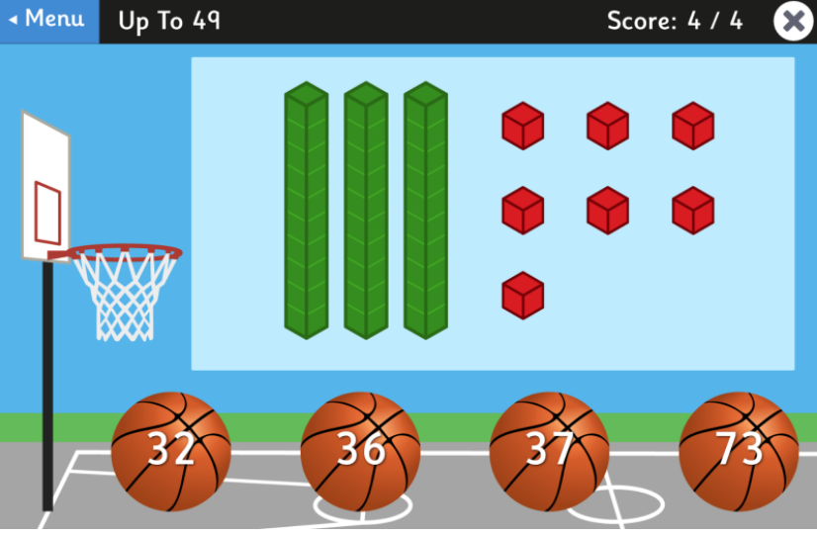
Design A Garden
A garden is a rectangular shape. The measurement around the perimeter (the outside edge) is 28 metres.
Draw what the garden plot might look like and write the measurements on each side.
Math word problems
Create 6 Math word problems and give it to somebody in your house to complete!
Eg: I went to the supermarket and bought 12 bananas. I ate 3 and used 4 to bake a cake. How many bananas did I have left?
Maths activity sheet
Stretch your maths brain with the activities on the NZ Maths link below.
Dice Game > < =
Roll a dice to make to make 2 x 2 digit numbers. Then put them into a greater than (>), less than (<) or equal to (=) equation.
For example:
Place Value Basketball
Test your place value knowledge by playing Place Value Basketball.
Mathletics
Log into Mathletics and complete the tasks set.
Hit the button
Practice your basic facts while playing this game!
Notes:
Click on picture for links to be available.

Slide 10
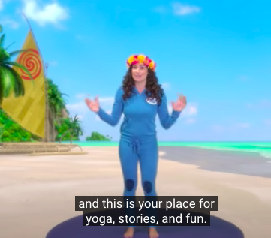
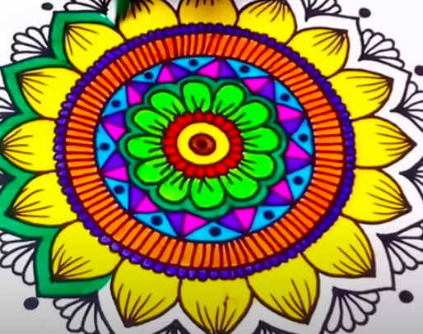
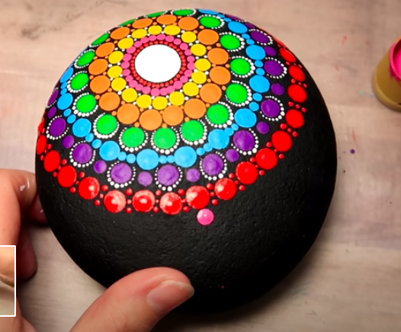
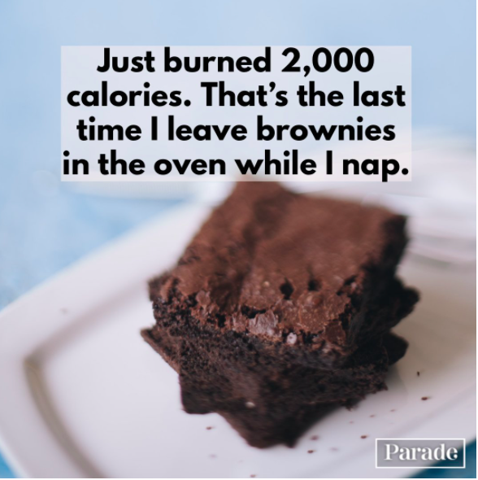
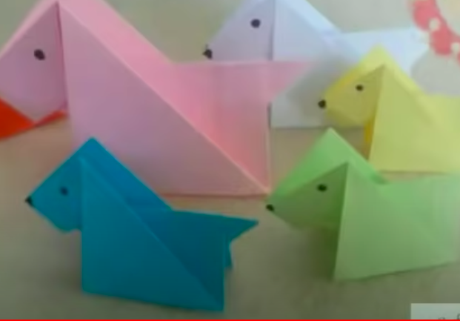
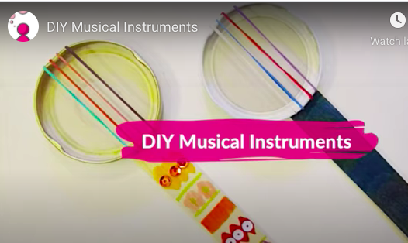
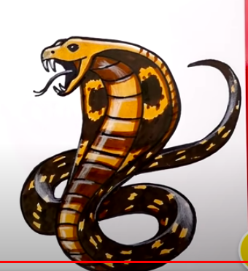
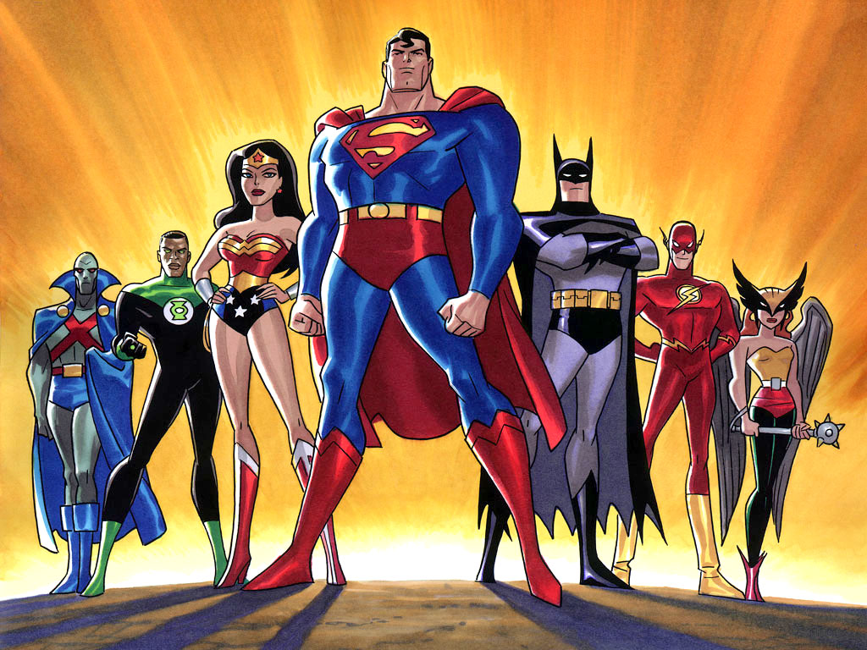
The Arts -
Dance
1.Stay active by doing yoga
https://www.youtube.com/watch?v=5y3gCrL_XIM
2.Create your own routine to your song and perform it to a family member
Visual Art
1.Make your own mandala Art
https://www.youtube.com/watch?v=iu29srJPjWw https://www.youtube.com/watch?v=trGBNJLtyl8
2.Create a self portrait or family portrait.
Use a pencil, shade and mount on card.
Use a mirror or photos to help.
3.Origami
https://www.youtube.
com/watch?v=wWVppdfYOx8
4. How to draw Cobra
https://www.youtube.com/watch?v=KAD2BrgUaZk
Drama .
1.Tell a joke to someone
https://parade.com/1040121/marynliles/one-liners/
2. Write your own play, about a superhero and perform with a family member
Music
Make an instrument and create a song
https://www.youtube.com/watch?v=i7vkNUVhNfQ

Slide 11
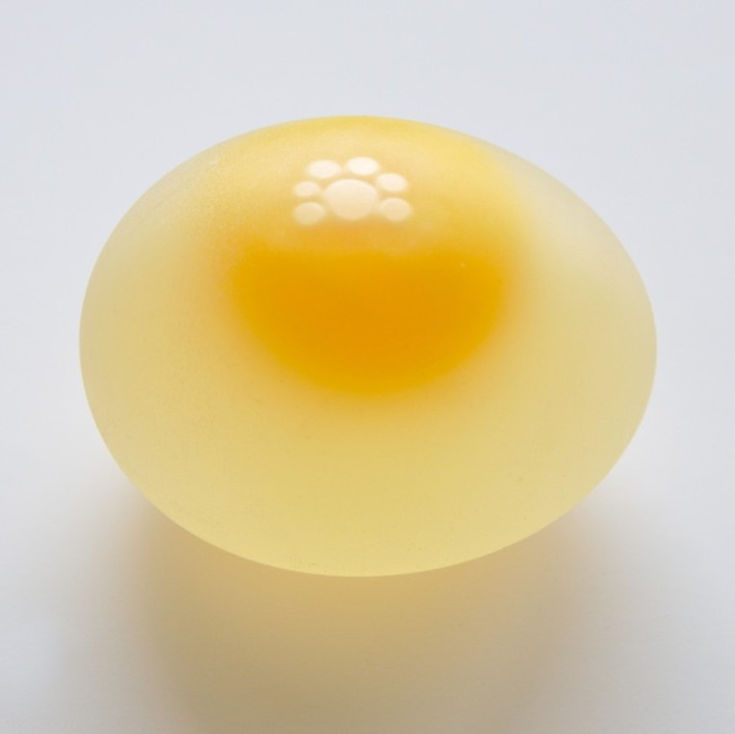
Science
Experiment 1 : Water Optical Illusion
Water Optical Illusion
EQUIPMENT : glass, water, note card, marker
INSTRUCTIONS : 1. Fill your glass of water.
2. Draw a horizontal arrow on a note card.
3. Draw another arrow underneath pointing the opposite direction on card
4. Put the note card behind the glass of water and slowly move the note card back up
5. Observe : Look through the glass from the front and observe the arrow.
6. Discuss :What appears to happen to it?
7. Response : Post a comment or photo about experiment.
Experiment 2 : Squishy Egg in Vinegar
EQUIPMENT : Egg, Vinegar, Glass
INSTRUCTIONS : 1. Watch video
2. Pour vinegar into glass
3. Place egg into glass
4. Watch for bubbles. Where do you think they come from.
5. Wait 24 hours,
6. Get your egg out, clean and dry. Is your egg soft and squishy all over or just in parts. If not ALL squishy put back into vinegar.
7. Wait 12 hours
8. Get your egg out, clean and dry. Your egg should be soft and squishy all over. If not put back for 12 hours again
9. Test your egg. (be careful not to break it) : Squeeze it, roll it, bounce it, shine light into it. When finished playing poke it with a pin on top to make a volcano.
10. Post photo or comment. What do you think happened to the shell ?
https://www.youtube.com/watch?v=khgOTDvG-4A&t=44s
https://www.youtube.com/watch?v=G303o8pJzls

Slide 12
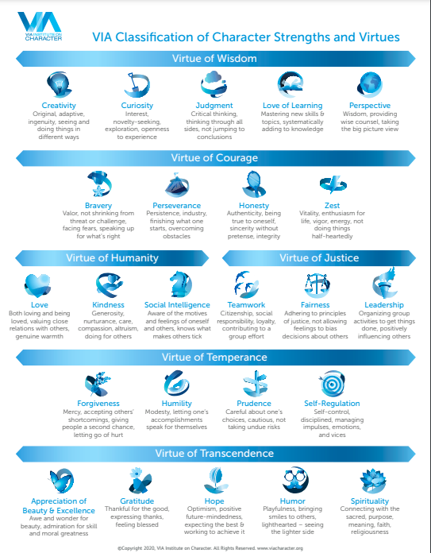
Inquiry - How do I Connect with Others?
Get your whole family to take the VIA Character Strengths Survey - talk about any character strengths you have in common, or areas that are unique to each of you. https://www.viacharacter.org/
How does this help your family function together?
Are there any strengths you would like to improve on?
Create a family crest / shield that shows all of your individual strengths and one strength that you all value as a family.

Slide 13
Card Stack Challenge
Use a pack of cards to stack on top of each other. What shapes can you create? How many cards can you use before it collapses?
Word challenge
How many words can you make from the grid below? Can you make a 9 letter word?
Crack the code
Write a message using a secret code and get a family member to try crack the code!
Design Challenge
Design a robot that helps out at home.
What would your robot do?
What would it look like?
Research Task
Choose a country and create a powerpoint that includes: Country flag, capital city, tourist attractions, things to do, places to eat etc.
Share the powerpoint with your teacher
Bird Watching
Have a go at identifying any birds you can see in your backyard or try this DOC bird identification online course.

