Slide 1
Christchurch East School
Team Harakeke 2022 Distance Learning Slide Deck 2

Slide 2
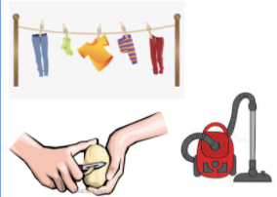
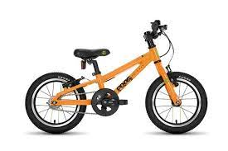
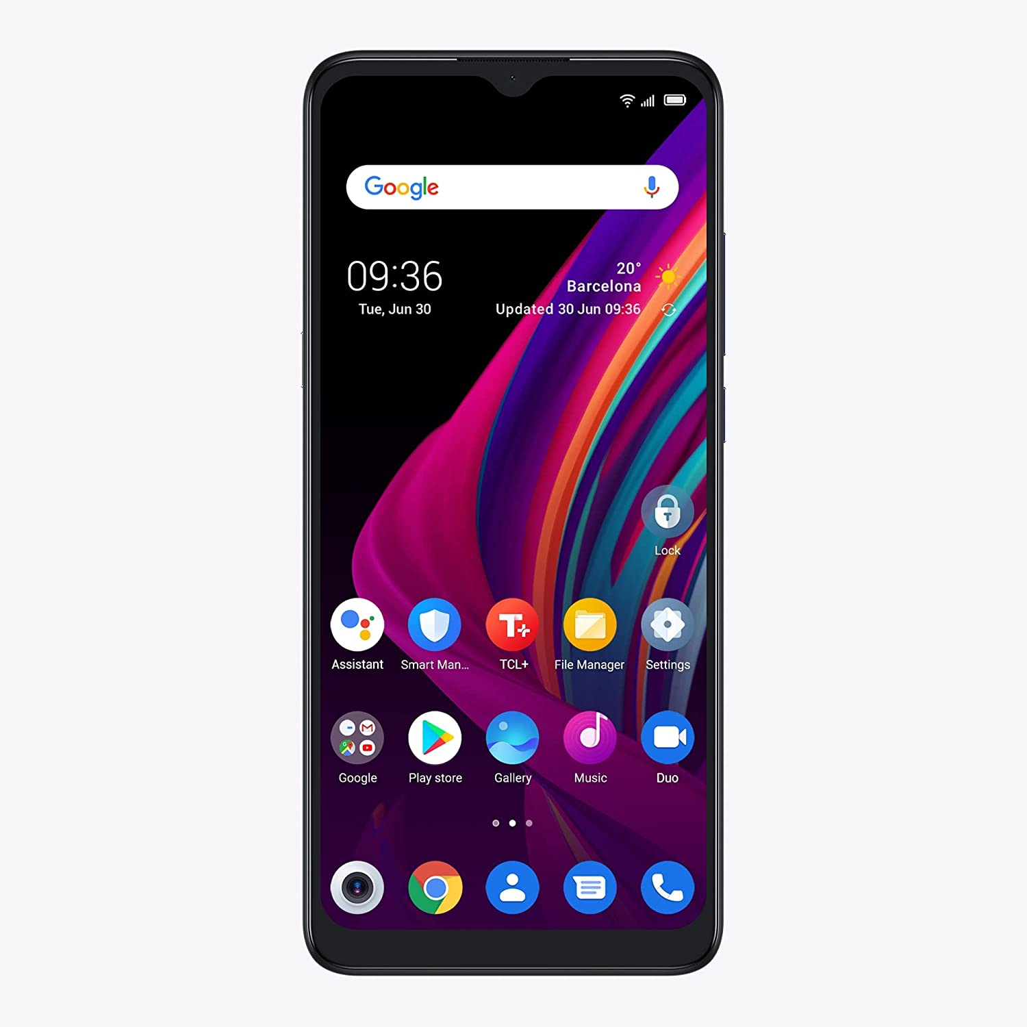
Five Ways to Wellbeing
Get Active | Give | Connect | Keep Learning | Take Notice
Bike ride Scooter ride | What can you do to help at home? . | Listen to some music. Ring a friend or family member | Mathletics Storyline online StepsWeb Look at the next slide . | Say thank you to someone who has helped you. Or look at ways you can help others.

Slide 3
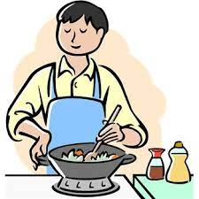
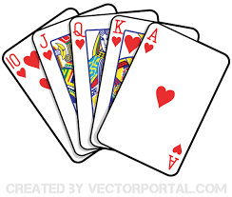
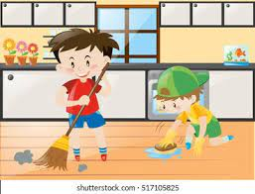
These things all count as learning.
Have you done any of these at home lately?
Colouring, drawing and painting
Listening to music
Baking
Puzzles
Cooking
Reading together
Writing letters and stories
Helping with the cleaning
Card Games
Making music
Check the weather forecast

Slide 4
Reading
LEARN - Research flightless bird species in New Zealand. How have they adapted to living on the ground? Which species are extinct?
CREATE - Write a poem that imagines what life was like in New Zealand before people arrived. You may like to incorporate some of your research into your poem or imagine a fictional landscape.
ILLUSTRATE - Study some famous New Zealand paintings of birds including works by Bill Hammond and Don Binney. Discuss their different styles with someone at home. Create an illustration for your poem in a style that fits your vision of early New Zealand.

Slide 5
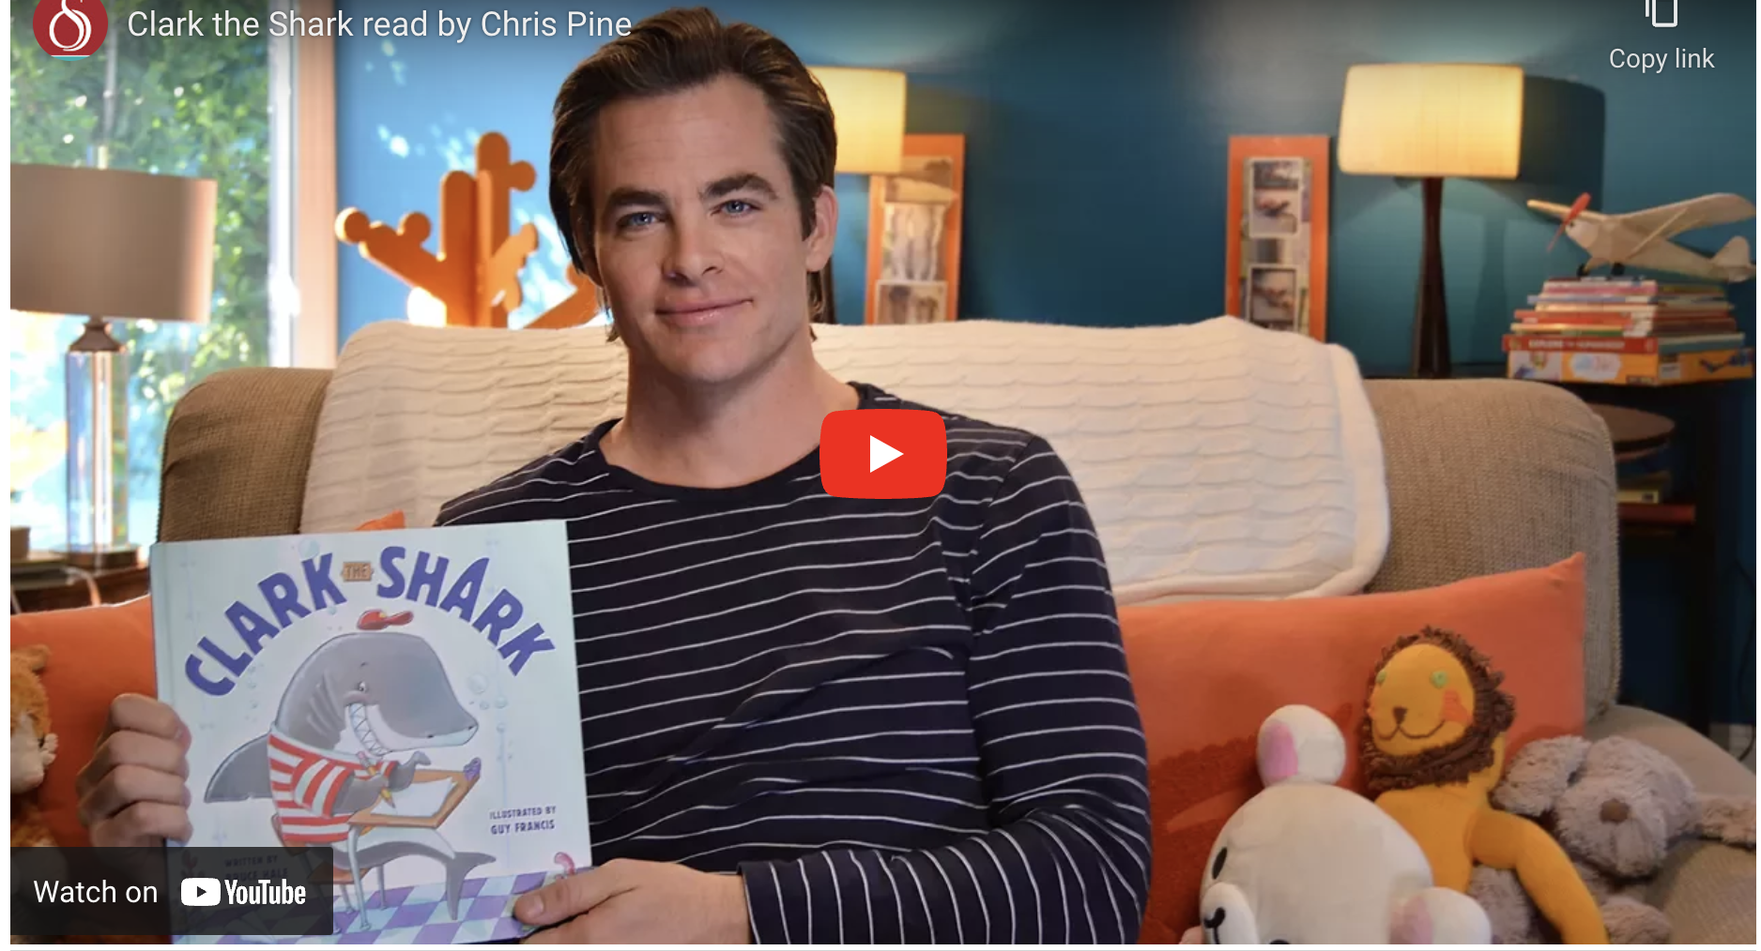
Reading
Clark the Shark

Slide 6
Reading
Stories online

Slide 7
David Walliams
Visit the site and complete one of the activities. Activities

Slide 8
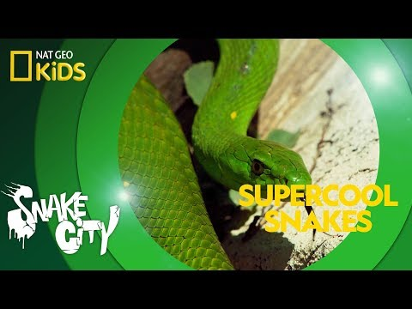
SNAKES

Slide 9
What’s the difference between an Alligator and a Crocodile?

Slide 10
Writing
Can you start a rhyming dictionary. If you have never seen a rhyming dictionary, it is a book that lists the words that rhyme with end sounds of other words. For example, if you want to find a rhyme for “cat,” you would look up “at” in a rhyming dictionary, because “at” is the ending sound of the word “cat.” The rhyming dictionary would give you a list of words, including “at,” “bat,” “cat”, “fat,” and so on.
Explore the online thesaurus. A thesaurus is a “dictionary of synonyms and antonyms”, allowing you to easily find words that “mean the same thing” or the opposite of a given word.

Slide 11
Writing
Home Disco - I wonder what you could do to have a Home Disco at your house this week?
Make an invitation to send to your family member to attend your Home Disco.
Make a menu of some snacks you want to have at your Home Disco.
How can you organise your lights for your Home Disco.
Make a list of what you will need to do and share this with your parents/caregivers.
Draw a diagram how you will set up a place in your house to run your Home Disco.
Write a playlist of songs you want to play at your Home Disco.

Slide 12
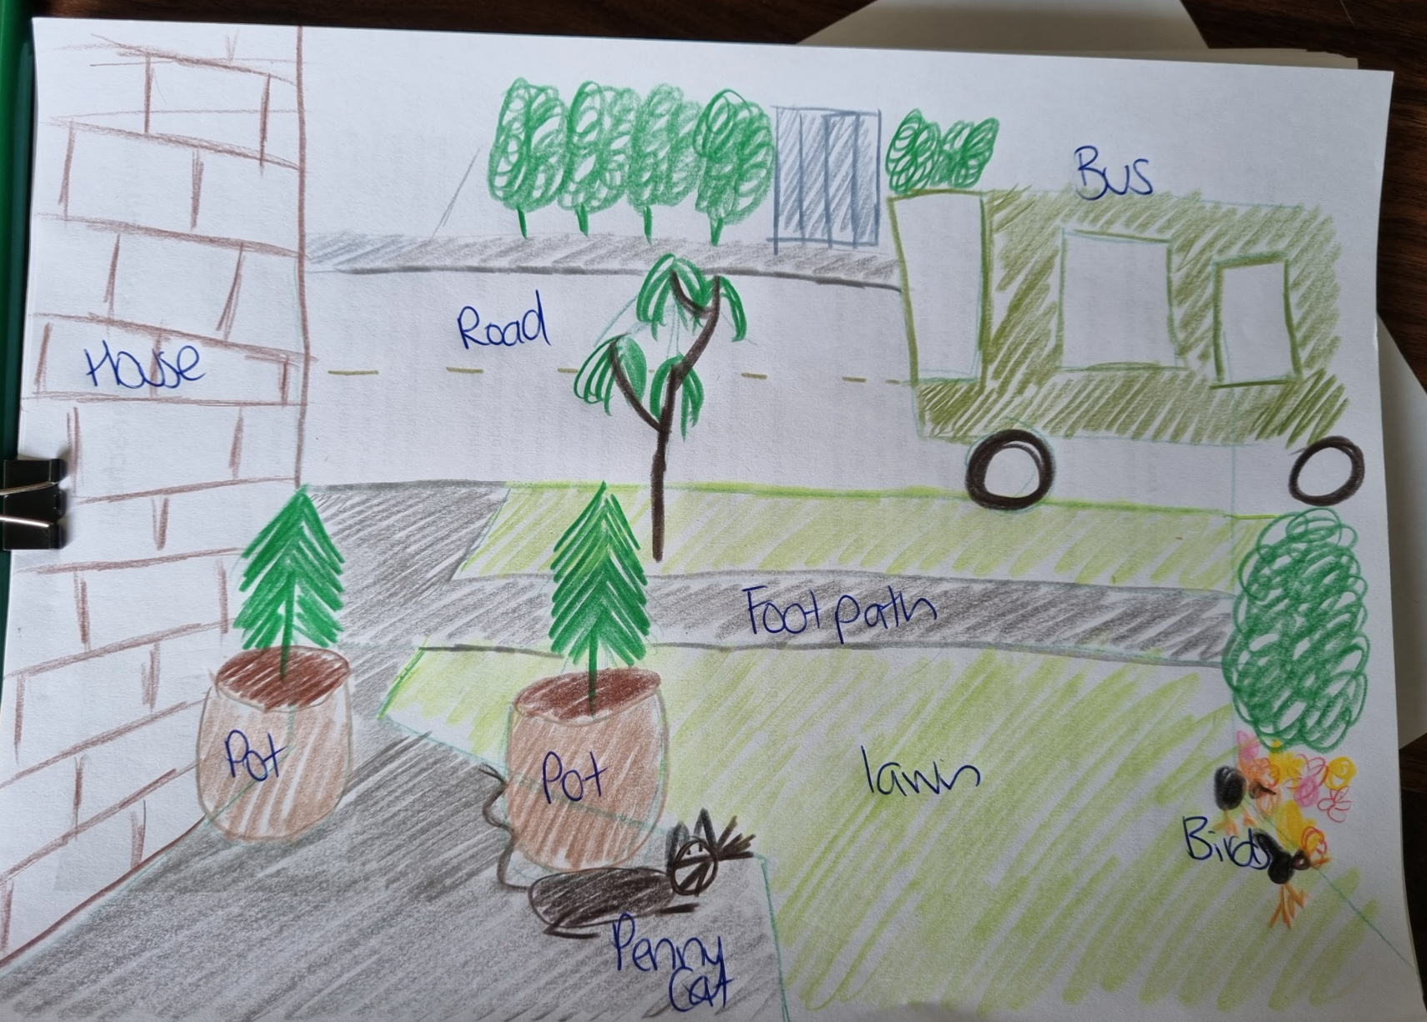
Writing
Spend 5 minutes looking out your front door.
Draw a picture of what you can see.
Label your picture with what you can see.
Write about what happened in the 5 minutes
you were looking out your front door.
Here’s what’s outside Miss Wilson’s front door…
OUT MY FRONT DOOR
Out my front door I can see the soft rain falling on the green lawn. My cat, Penny, hides from the cold, watching the birds dig in the garden for their dinner. The ground starts to shake as the big green bus rumbles down the road on its way to its next destination.

Slide 13
Maths
Snowflake Geometry - Using plain paper cut different 2D shapes such as: circles, triangles, rectangles, rhombus... The list goes on!
Use your cut out shapes to create a beautiful snowflake! Write a description of what shapes you used to make your snowflake!

Slide 14
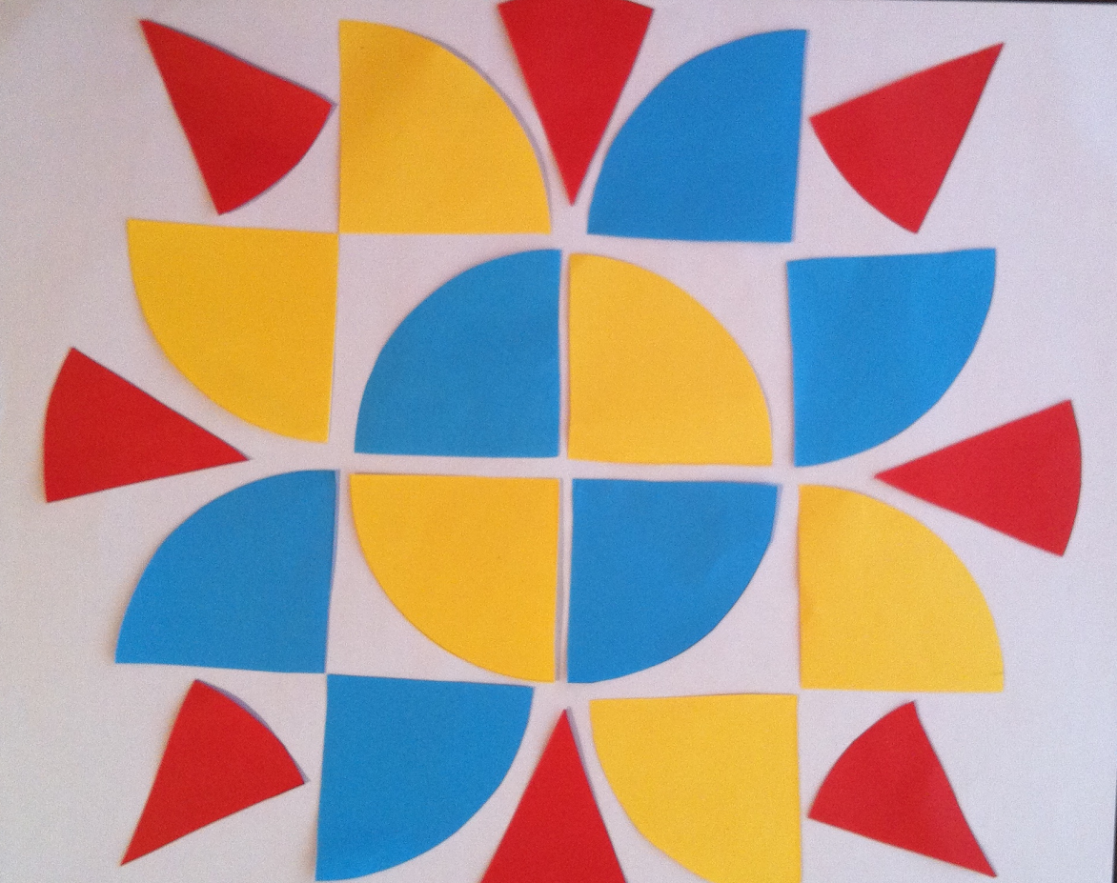
Maths
Fraction Art - Using some pieces of coloured paper cut up squares, rectangles, triangle, circles, anything that can be split into fractions, even pieces. Cut a range of fractions out of the shapes and then arrange them into a piece of collage art
I wonder what art you can make just out of squares?

Slide 15
Problem Solving

Slide 16
Problem Solving

Slide 17
Autumn Art - Draw a tree with that has no leaves on. Colour the background with autumn colours.

Slide 18
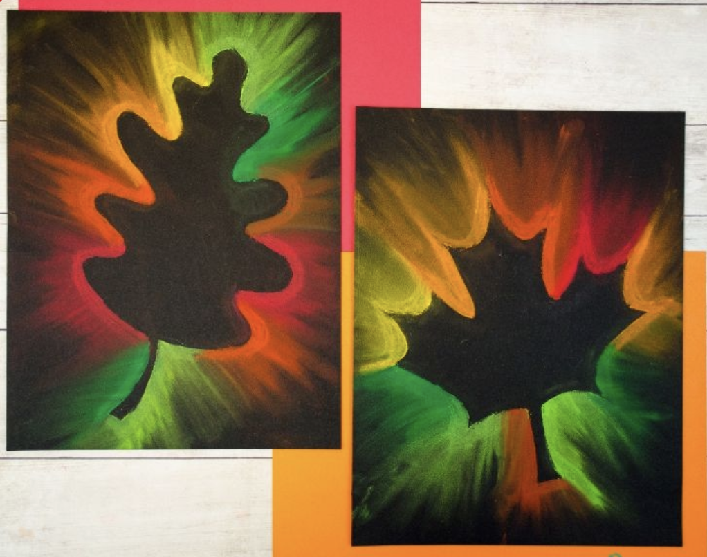
Autumn Art - Use pastels to create this effect.

Slide 19
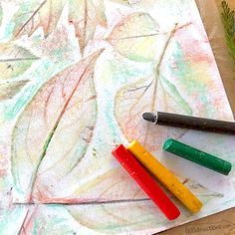
Collect some leaves from your garden or from around your neighborhood.
Place them under a piece of paper and use a pencil or crayon to rub over them.

Slide 20
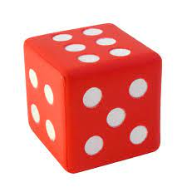
Fitness - Roll the Dice - 6 activities
Make a fitness course of 6 different activities.
Roll a dice and then complete the activity that matches the number.
Share your course activities with the your teacher.
Skipping -100 jumps, scooter to the end of the drive, throw and catch a ball, dribble a ball up and down the driveway for 5 times, throw a ball to hit a target or land in a bucket.

Slide 21
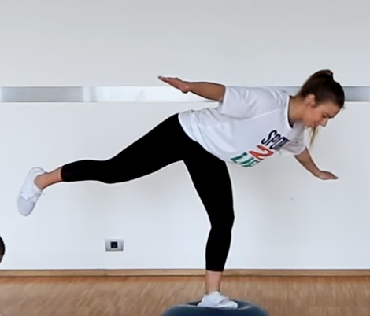
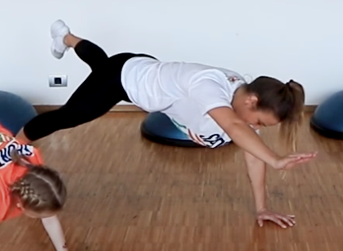
Physical Education - Balance
How good is your balance. Can you hold these positions for 10 seconds. Make sure you try both the left and the right sides.
Challenge: Close your eyes!

Slide 22
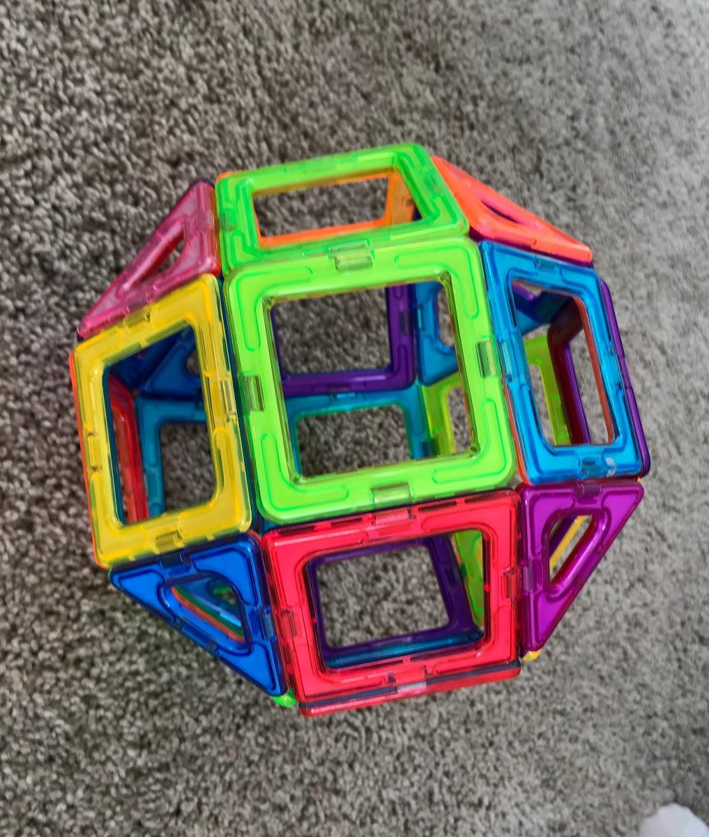
Science
Science - Magnets
Here is a fun video about static electricity - which experiments did you try and can you invent a game to share with the class?
Magnet fun at home - do you have some small magnets at home - look at these cool ideas on this video for things around your home to investigate their magnetic properties. What is magnetic in your kitchen? How about your bedroom? What types of materials are the most magnetic and why? We would love you to show us your findings!!!

Slide 23
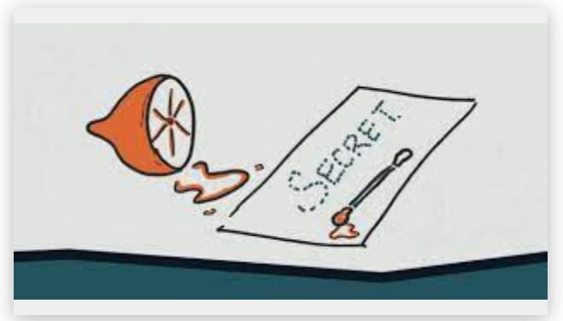
Science - Invisible Ink
Instructions:
Squeeze some lemon into a bowl and stir in a few drops of water.
Dip your cotton bud or toothpick into the juice and write a message on your white piece of paper.
Give your message to someone in your household. Get them to hold it up to the sun or close to a light bulb.
What’s the Science?
Diluting the lemon juice in water makes the lemon juice hard to see.
When the lemon juice it heated up it oxidizes and turns brown to reveal the message.
You could also try this experience with other liquids.
Does it work the same if you use milk, vinegar or juice?
You will need:
A bowl
Half a lemon
A spoon
Water
Cotton bud, tooth pick (something to write with)
White Paper

Slide 24
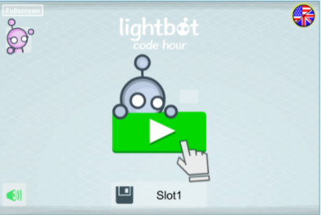
Digi Tech
Comics are great things to read as they can be short and funny!
Why don't you have a go at writing your own here are StoryBoardThat
Light Bot - Instructional coding app for basic direction programming. Start to learn programming by creating procedures and loops.

Slide 25
Extra
Click on this link to access all the Hour of Code activities https://code.org/hourofcode/overview
Coding is all about creating and following sets of instructions. This can either be physically or digitally. Below are 2 websites that are great examples of following instructions
Have you ever made a puzzle of yourself? Click on this website to upload an image and have it turned into an inline puzzle to complete.
Doppleme,com is a great site to create a graphical character of yourself

Slide 26
Extra for experts
Explore making a fort. Can you make one of these in your yard/house out of yard materials, in your lounge with sheets, in your bedroom with pillows.
Bake a cake following a recipe. Follow each step carefully and measure carefully, baking is a science!
Choose 2 of your most favourite animals and then combine them into one drawing.
Have you heard of a
Bullish (Bull and a Fish)
Cowmal (Cow and a Camel)
Zebog (Zebra and a dog)
Snaccodile (Snake and a Crocodile)

